Slide 1

Unemployment on Industries, Ethnicity and Gender.
Christopher Lynch, Stephanie Wortman, Tamica Grant, Jacob Darmofal, Scott McLean

Slide 2



Objectives
Unemployment
DATA & DELIVERY
BACK END
VISUALIZATIONS
2

Slide 3
Overview
Unemployment
Project Type:
Database Used:
Imported Library:
Interactive Feature:
HTML Dashboard
PostgreSQL
Highcharts js
Dropdown Menu
3

Slide 4

Data Collection
I
G
Unemployment
Industry
Gender
5 Data sets: all major and minor occupation industries
3 Data sets: either male or female
E
Y
Ethnicity
Year
3 Data sets: including African American, Asian, Caucasian and Hispanic backgrounds
All 12 Data sets: ranging from 1980-2023
4
Data retrieved from the U.S. Bureau of Labor Statistics

Slide 5

01
We are heading into a recession
Unemployment
Unemployment hit a peak in 2020
02
926,000 people unemployed in our current and/or future industry in 2021 and the number is increasing
Current Economy
03
5

Slide 6

2,554,000
Unemployment
6
Amount of people unemployed in the Leisure and Hospitality industry (2020)

Slide 7
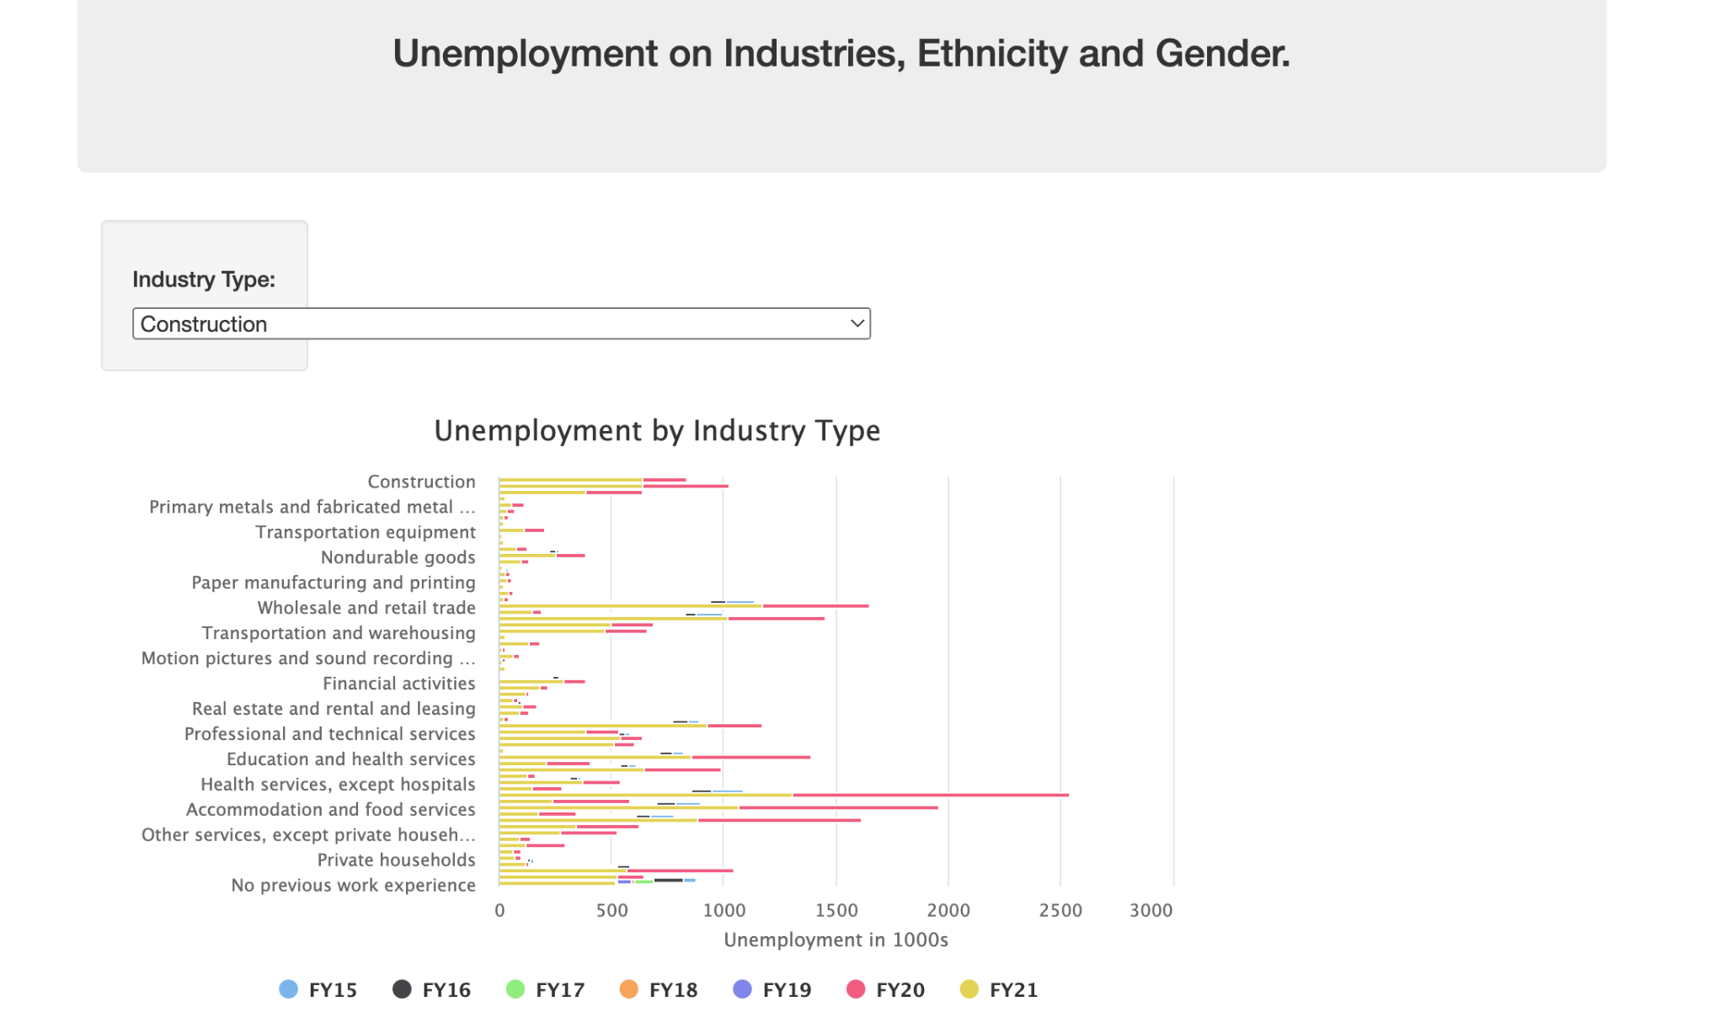
Preview
Unemployment
7

Slide 8
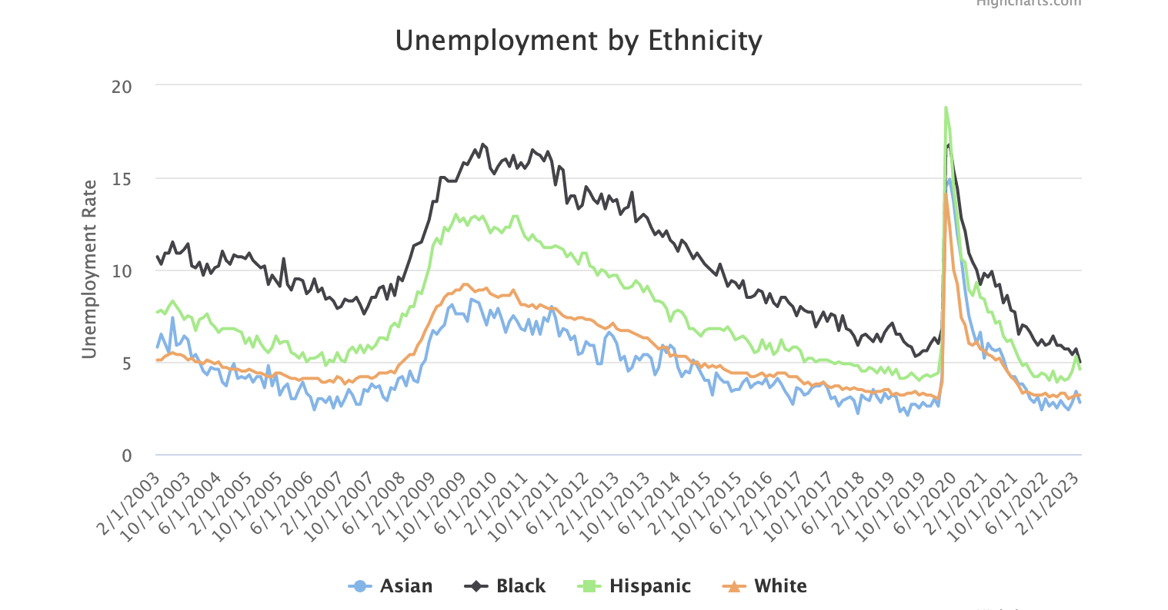
User-Driven Line Graph
Unemployment
We are able to interact with unemployment data by ethnicity
8

Slide 9
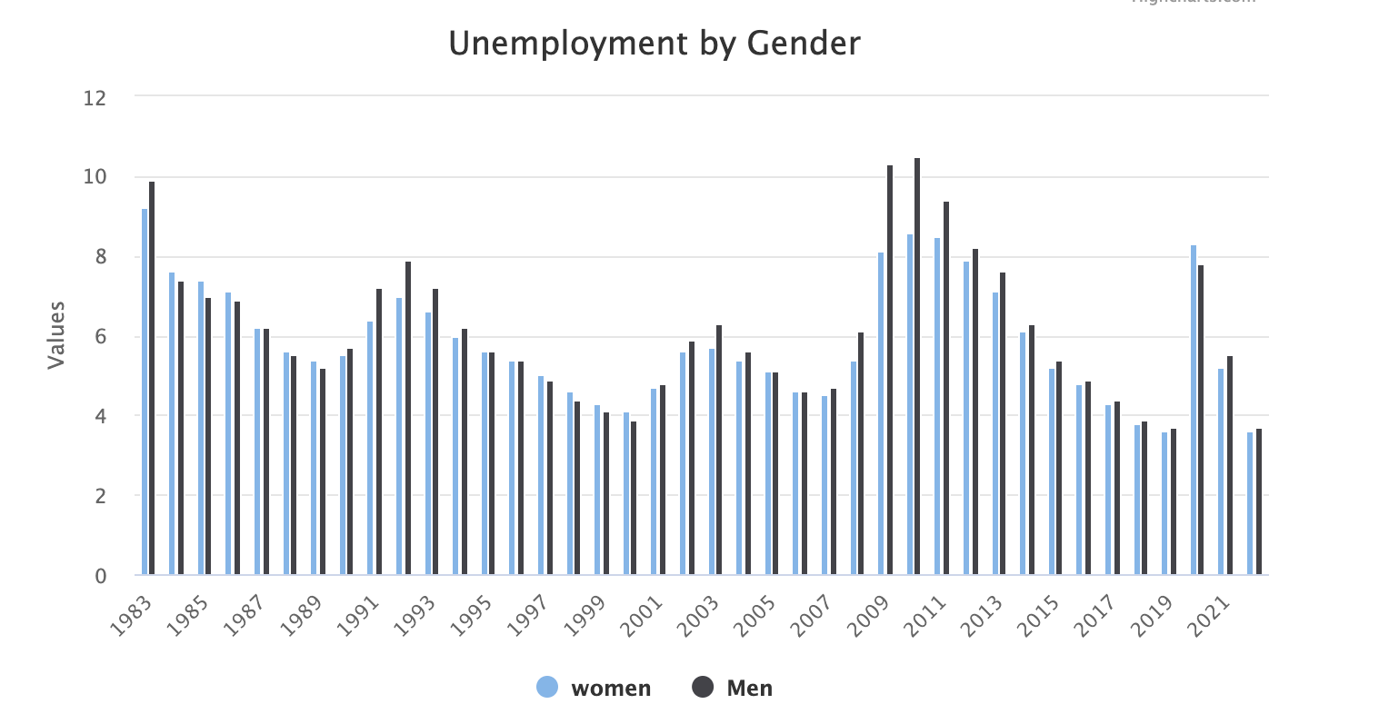
User-Driven Bar Graph
Unemployment
We are able to interact with unemployment data by gender on a year-to-year basis.
We can visually identify the constant ebbs and flows of the data dating back to 1983.
9

Slide 10
Thank you!
PROJECT TIMELINE
Questions/Comments?
PAGE NUMBER

